Slide 1
Modified DFS-based term weighting scheme for text classification
Abhishek Kumar (181CO201), Sasidhar Swarangi (181CO245)

Slide 2
Objectives
Implement Modified DFS-based term frequency (TF-MDFS) weighting scheme.
Compare and visualize the performance of TF-MDFS and other state-of-the-art term weighting schemes.
Apply TF-MDFS to more sophisticated text representations like N-grams, Skip-grams and Continuous Bag of Words.

Slide 3
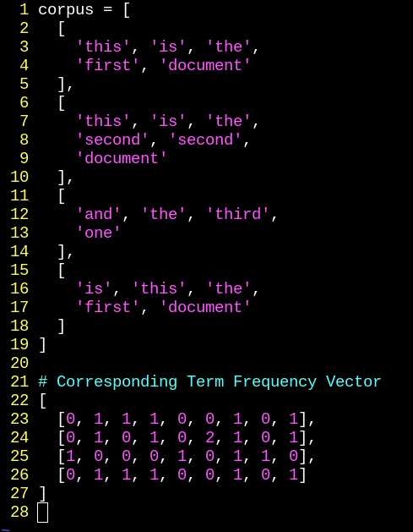
Vector Space Model
ML Models cannot operate directly on the textual data of the documents.
Using term-weighting schemes, the documents are transformed into vectors which can then be fed to models.
Examples: Term frequency, Term frequency-inverse document frequency weights
Designing appropriate term-weighting schemes is crucial.

Slide 4

Distinguishing Feature Selector
An ideal feature selection method should assign high scores to distinctive terms while assigning lower scores to irrelevant features. In particular, if a term:
Occurs frequently in a single class and does not occur in other classes, it is distinctive.
Occurs frequently in all classes, it is irrelevant.
Occurs rarely in a single class and does not occur in other classes, it is irrelevant.
Occurs in some of the classes, it is relatively distinctive.
TF-DFS was not effective as it assigns scores between 0.5 to 1.0 and does not demonstrate specificity adequately.

Slide 5
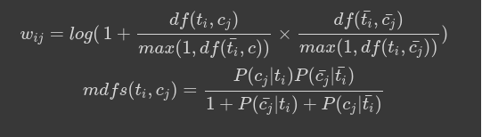
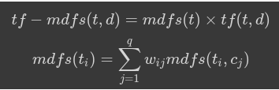
Modified DFS-based Term Frequency
A distinguishing feature must predict both true-positives and true-negatives.
Modified DFS is decomposed into q class-specific scores and is calculated from both “positive” and “negative” occurrences.
Modified-DFS based term frequency outperformed all existing term weighting schemes in accuracy.

Slide 6
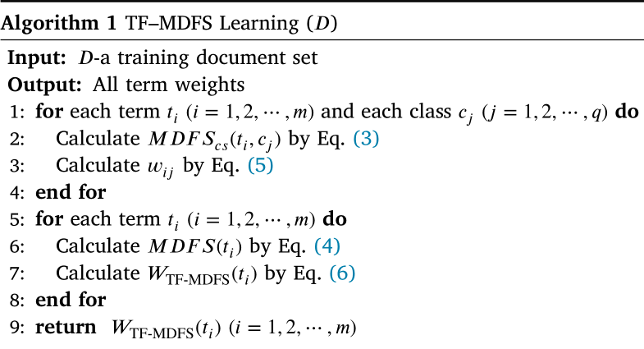
Computing TF-MDFS

Slide 7
Pros and Cons of TF-MDFS
Pros:
Utilizes the class labels as well to compute weights.
Outperforms state-of-the-art term weighting schemes.
Cons:
Computing TF-MDFS takes O(N * M) time where N is the number of classes and M is the number of documents, which can be infeasible for datasets with large number of classes.

Slide 8
Implementation (Open in Colab)
Load the datasets.
Preprocess the corpus - tokenization, word stemming, lemmatization and drop the stopwords.
Calculate weights (TF, TF-IDF and TF-MDFS) for the Vector Space Model.
Train Naive Bayes, Support Vector Machine and Logistic Regression on each term-weighting scheme.
Compute accuracy for each model, scheme and dataset.

Slide 9
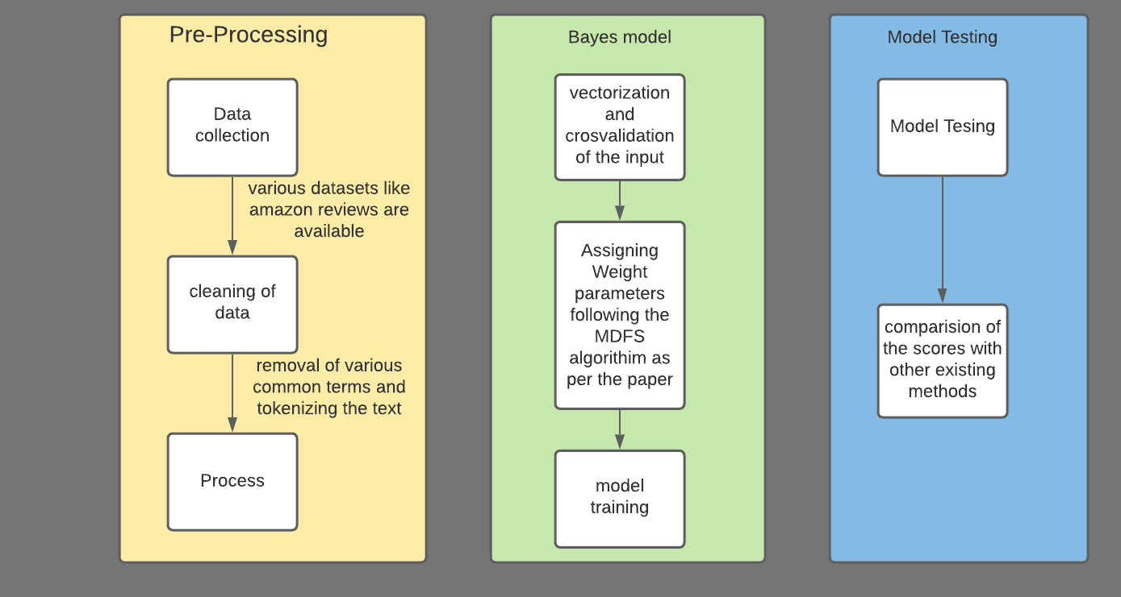

Slide 10
Results
Dataset | TF (%) | TF-IDF (%) | TF-MDFS (%) | Improvement over TF (%)
Amazon Review Dataset | 81.783 | 82.483 | 82.783 | 1.000
Polarity v2.0 Movie Review Dataset | 79.833 | 81.500 | 81.667 | 1.833
RSS Feed Topics Dataset | 64.681 | 64.965 | 65.362 | 0.681
Therefore, we find that TF-MDFS outperforms the existing term weighting schemes.

Slide 11
Our Contribution
Authors believed that applying TF-MDFS to more sophisticated text representations will make the improvement stronger.
We followed through, applying TF-MDFS to bigram representation of same datasets.
We also wanted to apply it to Word2Vec but couldn’t implement.

Slide 12
Accuracies for Bigram
Dataset | TF (%) | TF-IDF (%) | TF-MDFS (%) | Improvement over TF (%)
Amazon Review Dataset | 83.500 | 84.600 | 84.933 | 1.433
Polarity v2.0 Movie Review Dataset | 81.667 | 82.167 | 82.833 | 1.167
RSS Feed Topics Dataset | 65.730 | 63.574 | 67.972 | 2.241
Using TF-MDFS on more sophisticated text representations improves the advantage even further!

